Slide 1
Minitab tutorial by Tanmoy Das
PART 3

Slide 2
Data menu
Code
Change data type

Slide 3
Reliability
https://support.minitab.com/en-us/datasets/reliability-data-sets/dishwasher-reliability-data/
Reliability testing
Stat -> Reliability -> Distribution Analysis (Right censoring) -> Parametric Distribution Analysis

Slide 4
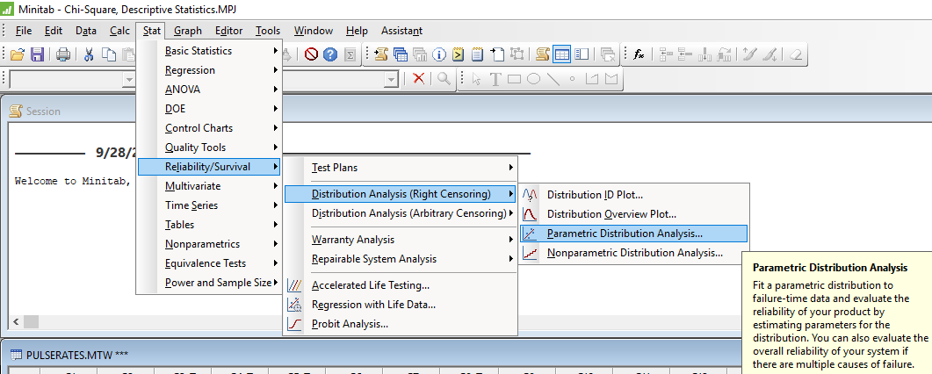

Slide 5
Time Series

Slide 6
Statistics
Chi square
https://support.minitab.com/en-us/datasets/tables-data-sets/pulse-rates-data/
Goodness of fit test

Slide 7
Multivariate
https://support.minitab.com/en-us/datasets/multivariate-data-sets/job-applicants-data/

Slide 8
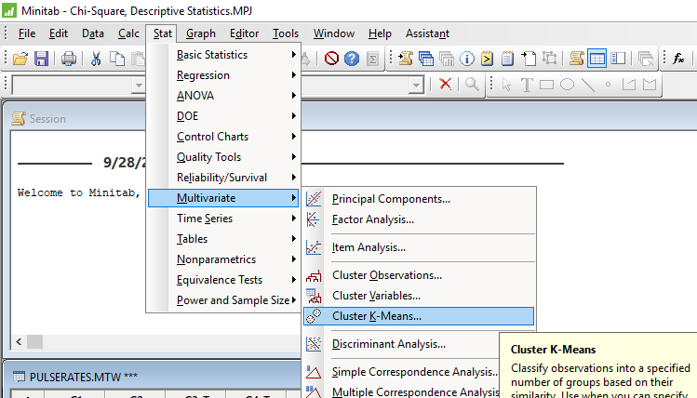
Multivariate

